Slide 1
clown

Slide 2
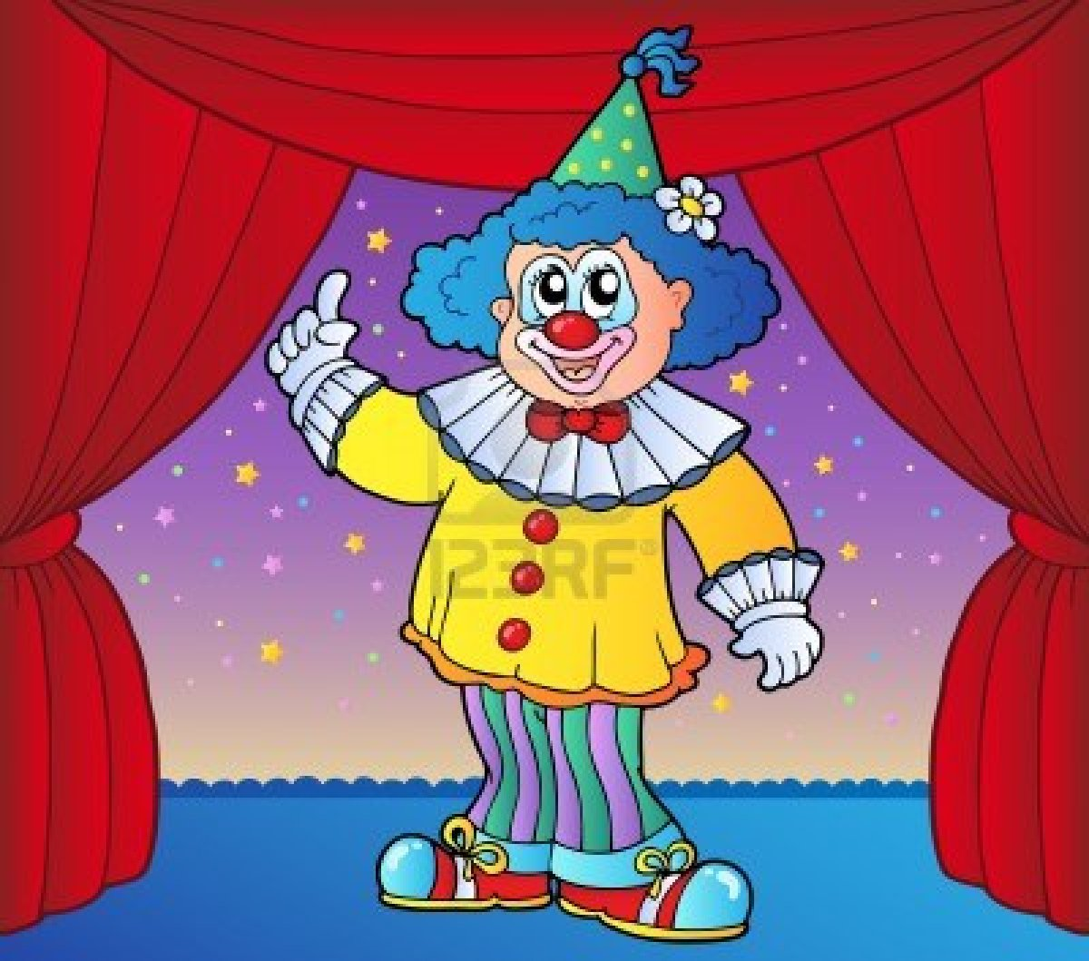
clown

Slide 3
nurse

Slide 5
guard

Slide 6
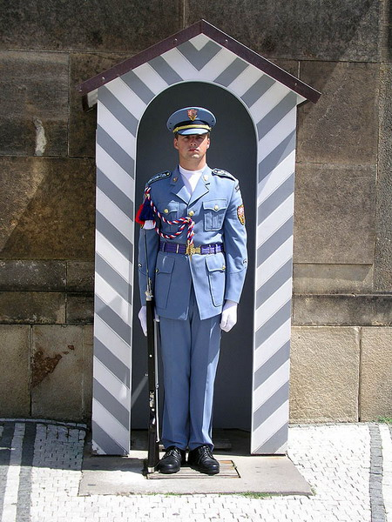

Slide 7
Balloon man

Slide 8
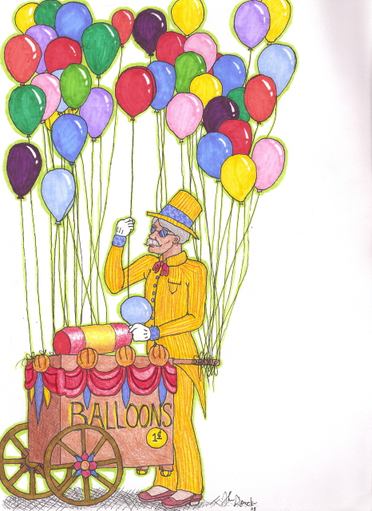
Balloon man

Slide 9
fireman

Slide 10
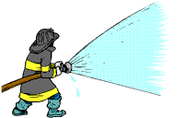

Slide 11
teacher

Slide 13
pupil

Slide 14
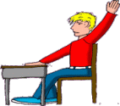

Slide 15
shopkeeper

Slide 17
doctor

Slide 19
driver

Slide 20
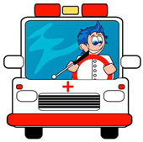

Slide 21
policeman

Slide 22
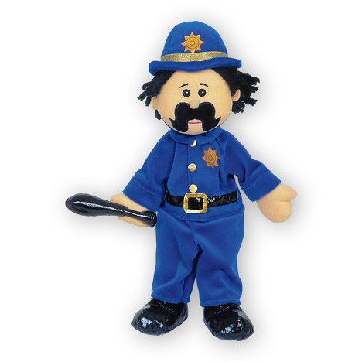

Slide 23
policestation

Slide 24
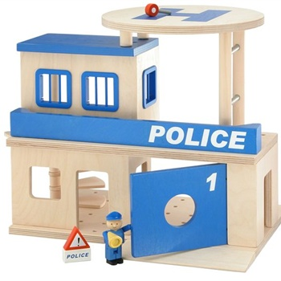

Slide 25
Fire station

Slide 26
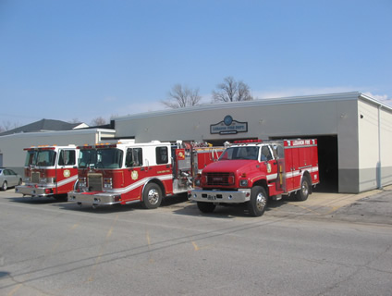
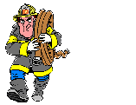

Slide 27
mall

Slide 28
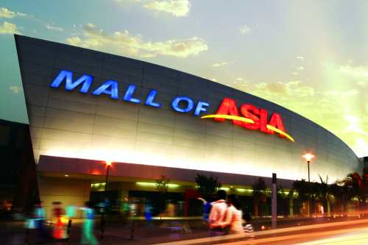

Slide 29
supermarket

Slide 30
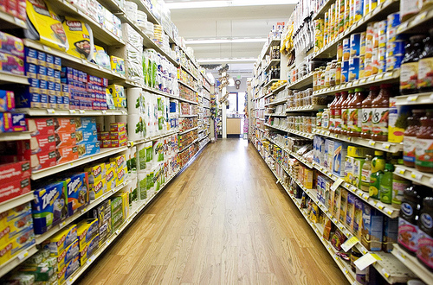
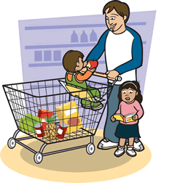

Slide 31
hospital

Slide 32
